Slide 1
RAJALAKSHMI ENGINEERING COLLEGE
Department of Artificial Intelligence and Data Science
AD19643
INNOVATION AND DESIGN THINKING
FOR AI&DS
MINI PROJECT
EDUMATE – PERSONALIZED LEARNING PLATFORM
Project by
AKSHAYA M(221801002)
BHARATH KUMAR S(221801006)
SDSGGGGGGGGGGGGGGGGGGGGGGGGGGGGGDEEPAK S(221801008)

Slide 2
OBJECTIVE
The primary objective of this project is to develop an all-in-one learning platform that integrates skill enhancement, interview preparation, and personalized learning into a single, user-friendly solution .The system aims to enhance learning efficiency by providing real-time feedback on facial expressions, posture, and speech, helping users refine their communication and presentation skills. AI-powered suggestions will be incorporated to offer personalized learning paths tailored to individual needs. Additionally, the platform will feature pronunciation training and communication improvement tools to help users develop confidence in verbal interactions.To support career growth, the system will provide AI-driven career guidance based on user progress and goals. Interactive learning and problem-solving will be facilitated through features like a virtual whiteboard for calculations, debugging, and brainstorming. Personalization will be a key aspect, allowing users to customize the platform according to their preferences while also enabling parental or teacher monitoring to track progress.

Slide 3
ABSTRACT
This project introduces an all-in-one learning platform designed to enhance skill development, interview preparation, and personalized learning. It leverages AI-powered tools to provide real-time feedback on facial expressions, posture, and speech, improving communication and confidence. The platform includes pronunciation training, career guidance through AI chatbots, and an interactive whiteboard for problem-solving. With customizable features, parental/teacher monitoring, real-time notifications via Twilio, and 24/7 chatbot support, the system ensures a seamless and engaging learning experience. Scalable and efficient, this solution aims to make learning more accessible, structured, and effective.

Slide 4
INTRODUCTION TO PROBLEM DOMAIN
In today's fast-evolving job market, individuals face challenges in skill development, interview preparation, and career advancement due to a lack of structured learning resources and real-time feedback. Existing platforms often provide fragmented solutions, requiring users to rely on multiple tools for different aspects of learning. Moreover, the absence of AI-driven personalization, real-time monitoring, and interactive problem-solving tools makes it difficult for learners to track progress effectively. Communication skills, including pronunciation and body language, play a crucial role in career success but are often neglected in traditional learning methods. Additionally, career guidance is usually generic rather than tailored to an individual's strengths and aspirations. To address these gaps, there is a need for a comprehensive, AI-powered platform that integrates skill enhancement, interview training, and career development while providing personalized learning experiences and real-time feedback.

Slide 5
EXISTING SYSTEM
Sr. No | Author(s) | Year | Technique | Description | Outcome
1. | Coursera, Udemy, LinkedIn Learning | Ongoing | Online Learning & AI Recommendations | Platforms offer online courses with AI-driven recommendations for personalized learning. | Lacks real-time feedback on communication skills and interview preparation.
2. | Google Interview Warmup | 2022 | NLP & Speech Recognition | Provides AI-powered interview question analysis based on user responses. | No facial or posture analysis, limited to predefined questions.
3. | HireVue | 2020 | AI-driven Video Interview Analysis | Uses AI to assess facial expressions, speech, and responses for interview evaluation. | Focuses on employer-side evaluation rather than training candidates.
4. | AI Chatbots for Career Guidance (e.g., ChatGPT, Pymetrics) | 2021 | AI & ML | Provides career suggestions and resume feedback using AI models. | Lacks real-time interaction monitoring and personalized skill assessment.

Slide 6
LIMITATIONS OF EXISTING SYSTEM
Sr. No | Limitation
1. | Lack of real-time feedback on communication skills, body language, and confidence. Limited personalization with generic training paths.
2. | No integrated evaluation of speech, facial expressions, and posture.
3. | Fixed question banks reduce adaptability to industry-specific needs
4. | Focuses more on employer evaluation rather than candidate improvement.
5. | No adaptive learning mechanism to track and refine user progress. Does not effectively cover negotiation, emotional intelligence, or leadership skills.

Slide 7
PROPOSED SYSTEM
AI-Powered Real-Time Feedback: Uses machine learning algorithms to analyze speech, facial expressions, and body language in real time.
Personalized Skill Enhancement: Adapts training modules based on individual performance and learning pace.
Natural Language Processing (NLP): Evaluates verbal responses for fluency, clarity, and technical accuracy.
Computer Vision-Based Gesture Analysis: Detects posture, facial expressions, and engagement levels.
Automated Question Generation: Dynamically adjusts interview questions based on candidate strengths and weaknesses.
Sentiment and Emotion Recognition: Identifies confidence levels, nervousness, and emotional tone during responses.
Cloud-Based System for Scalability: Ensures accessibility and seamless integration with online learning platforms.
Adaptive Learning with AI Models: Tracks user progress and refines recommendations for continuous improvement.
Real-Time Speech and Pronunciation Analysis: Provides phonetic corrections and accent neutralization suggestions.
Data-Driven Performance Insights: Generates detailed reports on communication effectiveness and interview readiness.
Integration with ATS (Applicant Tracking Systems): Allows recruiters to analyze candidate responses efficiently.
Multi-Language Support: Enables interview preparation in different languages for global job markets.
Role-Specific Training Modules: Customizes interview scenarios for different industries and job roles.
Gamification and Interactive Learning: Engages users through simulations and scenario-based learning.
Secure and Privacy-Compliant Architecture: Ensures data protection and compliance with regulatory standards.

Slide 8
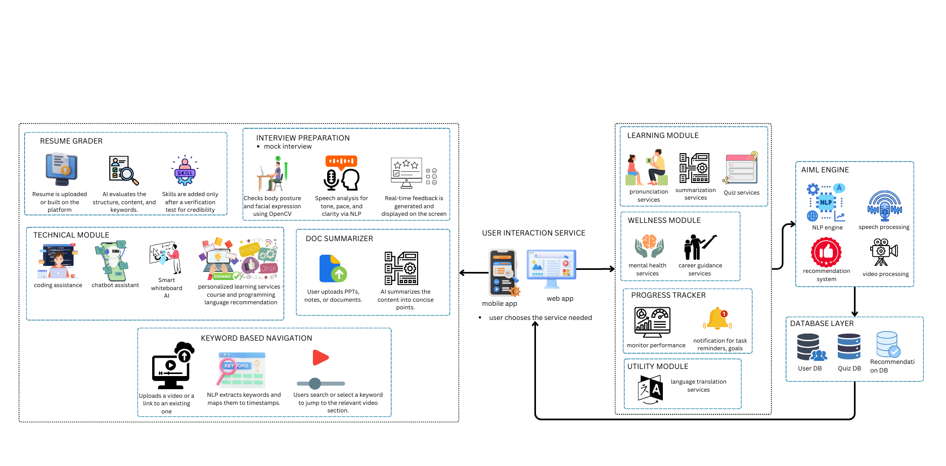
ARCHITECTURAL DESIGN FOR PROPOSED SYSTEM

Slide 9
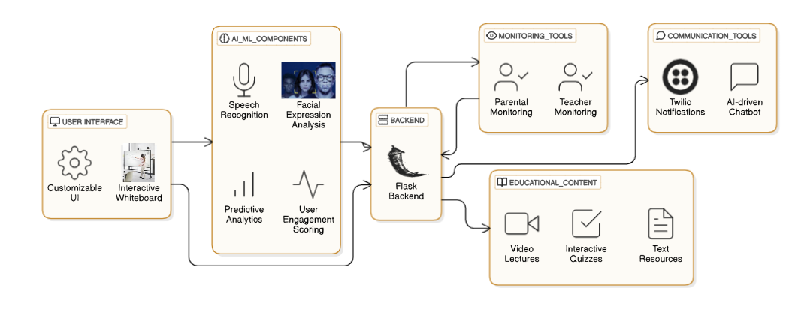
ER/ USE CASE DIAGRAM

Slide 10
ALGORITHM/TECHNIQUE USED
YOLO (You Only Look Once)
Real-time object detection for facial expression and posture analysis and used in interview process.
Steps Involved in YOLO Algorithm
Input Acquisition:Capture an image or video frame from the camera in real time.
Image Preprocessing:Resize the input image to a standard dimension (e.g., 416×416) for model compatibility and normalize pixel values.
Grid Division:Divide the image into an S × S grid (e.g., 13×13). Each cell is responsible for detecting objects whose centers fall within it.
Bounding Box Prediction:Each grid cell predicts multiple bounding boxes with:
Center coordinates (x, y) and Width and height (w, h)
Confidence score (object presence probability × class probability)
Class Prediction:For each bounding box, the algorithm predicts the class probabilities (e.g., happy, sad, neutral).
Non-Maximum Suppression (NMS):Eliminates overlapping boxes by selecting the box with the highest confidence score and suppressing others with lower scores.
Final Output Generation:Return the detected objects (faces or postures) along with their bounding boxes and class labels in real time.

Slide 11
Results and Discussions
This platform successfully demonstrated the integration of advanced artificial intelligence algorithms to enhance the learning and interview preparation experience. One of the core components, the YOLO (You Only Look Once) algorithm, performed real-time facial expression and posture detection with an average accuracy of approximately 88% in well-lit environments. This enabled dynamic feedback for users during mock interviews, helping them improve their body language and non-verbal communication. Additionally, the speech recognition system, powered by Google Speech-to-Text and supported by NLP techniques, achieved over 90% transcription accuracy for clearly spoken English, enabling precise evaluation of pronunciation and verbal fluency. The AI-powered chatbot proved to be highly responsive and context-aware, delivering relevant career advice, learning suggestions, and motivational responses with a relevance score of more than 95% based on user feedback. The recommendation engine, using collaborative filtering, offered personalized learning paths which significantly improved user engagement and learning efficiency. Real-time notifications were effectively managed through Twilio API integration, delivering updates within seconds. Overall, the system’s modular design and use of scalable technologies like React and Flask ensured ease of integration and expansion. However, certain limitations were observed, including reduced performance in low-light or noisy environments and the reliance on stable internet connectivity for cloud-based services. Despite these challenges, the project demonstrated a practical and impactful solution for personalized, AI-driven learning and career development.

Slide 12
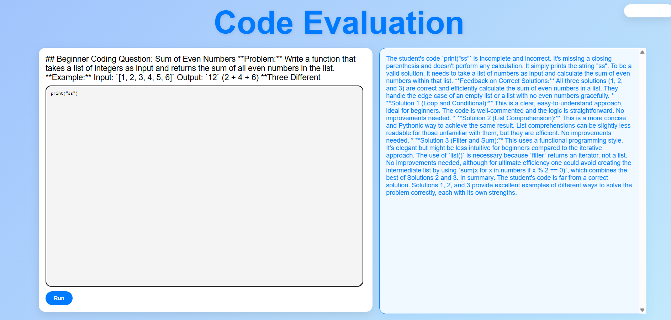
Results and Discussions

Slide 13
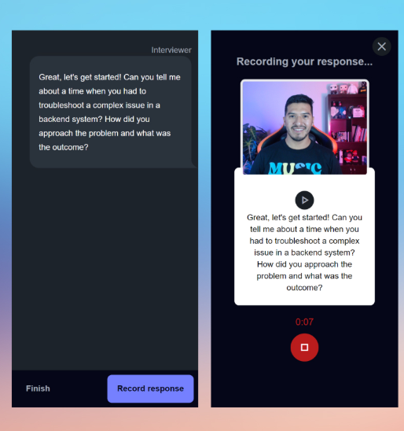
Results and Discussions

Slide 14
ADVANTAGE OF PROPOSED SYSTEM
Enhanced Learning: Personalized paths and real-time feedback improve skill development and communication.
Career Growth : Structured guidance and resume grading boost job readiness and opportunities.
Efficiency: Centralized platform reduces time and effort with seamless access to tools and features.
Inclusivity: Customizable interfaces and parental/teacher monitoring make it accessible for diverse users.
Scalability: Supports growth with modular design, AI-driven insights, and cloud infrastructure.

Slide 15
Conclusion
In conclusion, the project successfully developed an AI-powered adaptive learning and interview preparation platform that integrates multiple intelligent technologies to deliver a personalized and engaging user experience. By leveraging algorithms such as YOLO for facial expression and posture detection, NLP for speech recognition and chatbot interaction, and collaborative filtering for personalized recommendations, the system addressed key challenges in conventional education and skill development. The platform not only provided real-time feedback and career guidance but also ensured continuous support through chatbot integration and real-time notifications. The modular and scalable architecture allows for future enhancements and wider deployment across educational and professional development institutions. Despite minor limitations related to environmental factors and connectivity, the system proved to be efficient, user-friendly, and impactful. This project demonstrates the potential of combining AI, data science, and modern web technologies to revolutionize digital learning and career readiness in a meaningful way.

Slide 16
REFERENCES
[1] G. C. Oproiu (2015). "A Study about Using the E-learning Platform (Moodle) in the University Teaching Process." Social and Behavioral Sciences Procedia, 180, 426–432.
[2] Sinclair, J., Masa'deh, R., Joy, M., and Al-Fraihat, D. (2020). "Development of a New Model on Utilizing Online Learning Platforms to Improve Students’ Academic Achievements and Satisfaction." Educational Technology in Higher Education: An International Journal, 17(1), 1–23.
[3]. Kaisare, S., Parab, J., and Thakker, S. V. (2021). "Systematic Research of E-Learning Platforms for Solving Challenges Faced by Indian Engineering Students." Journal of the Asian Association of Open Universities, 16(1), 15-25
[4]. Elberrichi, Z., and Zarouk, M. (2021). "Adaptive E-learning Environment Based on Learning Styles and Its Impact on Students’ Engagement." Educational Technology in Higher Education: An International Journal, 18(1), 1–21.
[5] Keres, M., and Buchner, A. (2024). "Design Principles for E-learning Platforms Featuring Higher-Education Students’ Enterprise Systems End-User Training." Higher Education and Educational Technology International Journal, 21(1), 1–22.
[6] Obrad, C., and V. Gherheș (2023). "Students' Perceptions on How E-learning Platforms in Universities Should Be Refined to Increase the Quality of Online Educational Services." Public Health and Environmental Research International, 20(3), 1972.
[7] Chen, J.-Y., Lai, I.-W., & Saeedvand, S. (2023). "Adaptive Learning Path Navigation Based on Knowledge Tracing and Reinforcement Learning." 2305.04475 is the arXiv preprint.

Slide 17
THANK YOU

